Slide 1
Operating Systems Basics
Module 1
ITSC205
Operating Systems Internals

Slide 2
Module Objectives
Define key operating system terms
Outline the historical development of general purpose computer systems
Describe computer system architectures
Describe computer system environments
Describe the general operation of computer systems, including interrupt structure

Slide 3
What is an Operating System?
Operating System: A program ( code) written in high-level programming language such as C and C++ that conveniently provides computer system resources to users/applications of a computer system.
What are the “resources”?
Who/what are the “users”?
What is meant by “conveniently”?

Slide 4
What is an Operating System?
Operating System manages system’s hardware and software and it can be defined from different points of view.
From the system point of view:
OS is a resource allocator
Manages all system resources such as CPU time, Memory space, file-storage space, I/O devices
OS is a control program
Controls execution of programs to prevent errors and improper use of the system

Slide 5
OS Definition
From the user point of view the operating systems should be fast and ease to use
Operating system is the kernel (main functions ) required to run the system– a program running at all times on the computer. Other instructions or lines of code are considered system programs (ships with the operating system) associated with the OS but not part of the kernel.

Slide 6
Operating Systems
Operating Systems Timeline
https://en.wikipedia.org/wiki/Timeline_of_operating_systems
Windows Timeline
https://en.wikipedia.org/wiki/Timeline_of_Microsoft_Windows
Linux History
https://www.youtube.com/watch?gl=SG&hl=en-GB&v=AvfTZmecifc

Slide 7
Linux and POSIX
POSIX (Portable Operating Systems Interface , based on UNIX)
Intended to standardize Unix operating systems.
Originated by the ISO, but in 1986 IEEE appointed a committee to publish a formal standard for Operating systems environment called POSIX.1, published in 1990
POSIX.1 : is a C programming language interface standard. Specifies syntax and semantics
https://ieeexplore.ieee.org/document/8277153
POSIX.2: Specifies the syntax and semantics of a shell command language

Slide 8
Operating System Structure
Batch Job Processing
Jobs with similar needs running through the computer as a group. This system is good for executing large jobs that need little interaction.
Multiprogramming needed for efficiency
Single user cannot keep CPU and I/O devices busy at all times
Multiprogramming organizes jobs (code and data) so CPU always has one to execute
A subset of total jobs in system is kept in memory
One job selected and run via job scheduling
When it has to wait (for I/O for example), OS switches to another job

Slide 9
Operating System Evolution
Timesharing (TS) (multitasking) CPU switches jobs so frequently that users can interact with each job while it is running, creating interactive computing
Response time should be < 1 second
Each user has at least one program executing in memory process
If several jobs ready to run at the same time  CPU scheduling
If processes don’t fit in memory, swapping moves them in and out to run
Virtual memory allows execution of processes that are not completely in memory

Slide 10
Real-Time Systems
Real-Time Systems –Hard and Soft
Real time systems are critical-time systems that provide inmediate response
Real time systems are classified as hard real time systems such as medical systems, NASA, process control system or soft real time systems are less time-critical systems that allow delay such as games, multimedia, virtual reality

Slide 11
Computer SYSTEM COMPONENTS

Slide 12
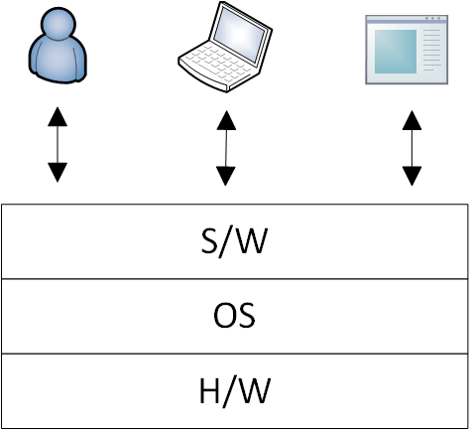
Overview of a Computer System

Slide 13
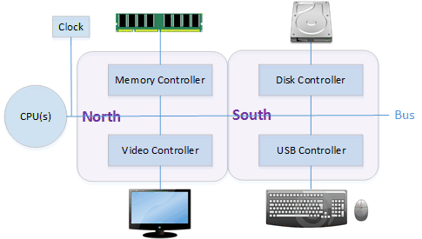
A Typical Computer System
Notes:
What is a bus? Which component is responsible for coordinating activity on the shared bus?

Slide 14
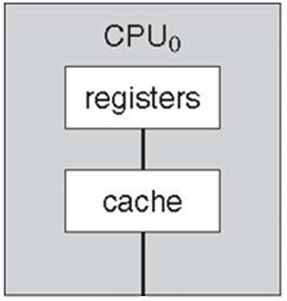
CPU Components
ITSC205 Operating Systems Internals

Slide 15
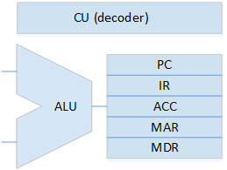
CPU Components

Slide 16
Von Neumann Architecture
One set of memory for all program and data
CPU must follow Instruction Cycle:
Fetch
Decode
Execute
Notes:
Which step(s) in the instruction cycle does NOT require memory access?

Slide 17
Single vs. Multiprocessor
Single: one general purpose CPU
Can have multiple special-purpose CPUs
Multiprocessor: two or more CPUs operating in parallel to augment system performance
Shares all system resources – costs less than multiple single-processor systems
Mitigate downtime (graceful degradation, fault tolerant)
Notes:
Note: CPU and processor generally means the same thing, some people refers to a processor is what the manufacturer sells as a “package”… e.g. i7 w/ 8MB cache, internally has 4 cores, sold as a “i7 processor”.

Slide 18
Multiprocessing
Use of more than one CPU in a system, i.e. a multiprocessor system
Not the same as “multiprogramming” – ability to execute more than one program at a time
Asymmetric multiprocessing: master/slave (central control), master controls all work to be done by slaves
Symmetric multiprocessing (SMP): peers, any task can be done by any CPU
What controls the distribution of work?

Slide 19
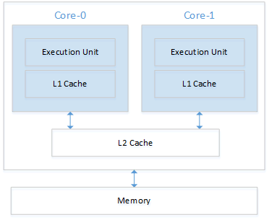
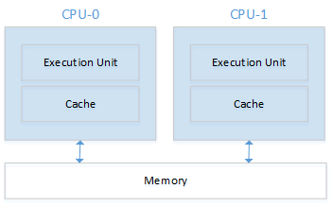
Multiprocessor vs. Multi-core

Slide 20
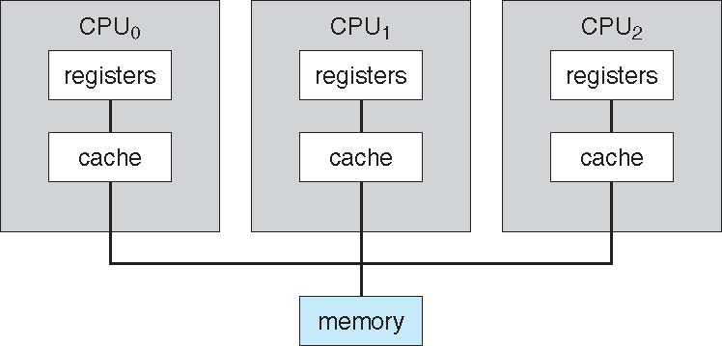
Symmetric Multiprocessing Architecture
ITSC205 Operating Systems Internals

Slide 21
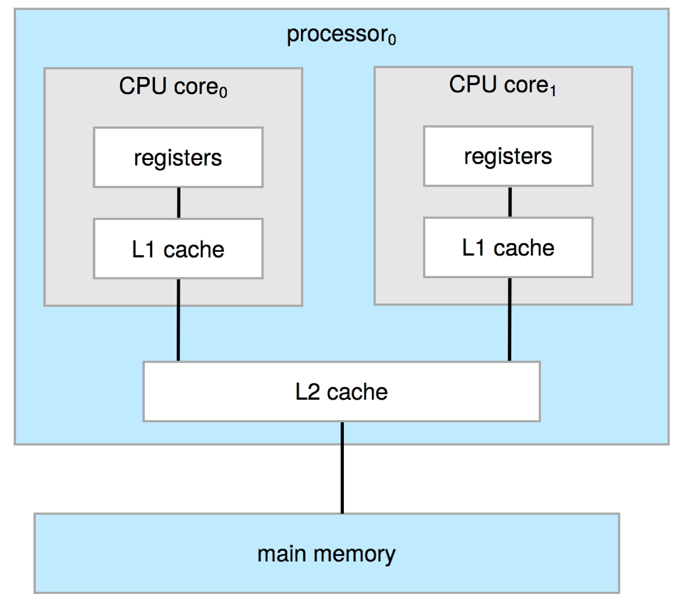
A Dual-Core Design
Multi-chip and multicore
Systems containing all chips
Chassis containing multiple separate systems
It supports UMA (Uniform Memory Access) and NUMA(Non-Uniform memory Access)
ITSC205 Operating Systems Internals

Slide 22
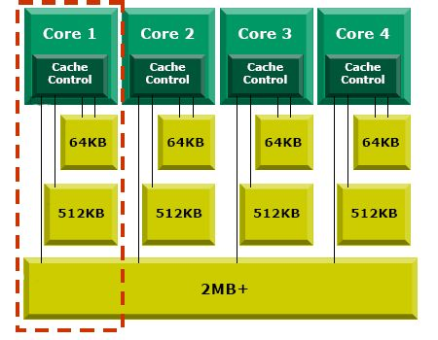

Quad Core
ITSC205 Operating Systems Internals

Slide 23
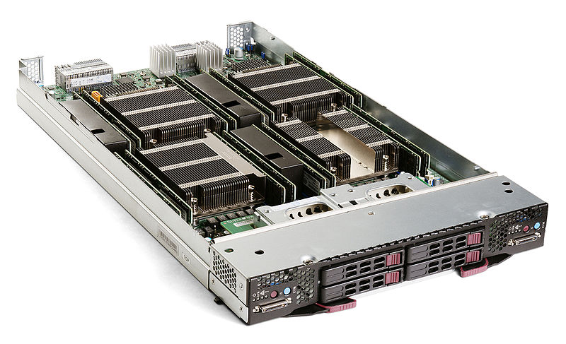
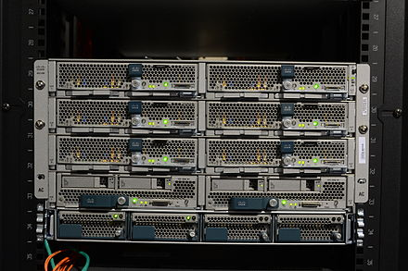
Blade Servers
Has its own processor board and OS to operate independently
Shared power supply, cooling system and networking modules
Each can have more than one CPU and cores
Supermicro SBI-7228R-T2X blade server, containing two dual-CPU server nodes
Cisco UCS blade servers in a chassis

Slide 24
Tools to verify hardware settings
Linux
lscpu
lshw
dmesg | grep cpu
dmidecode -t processor
Windows
Task Manager → Performance
System Information

Slide 25
OS components

Slide 26
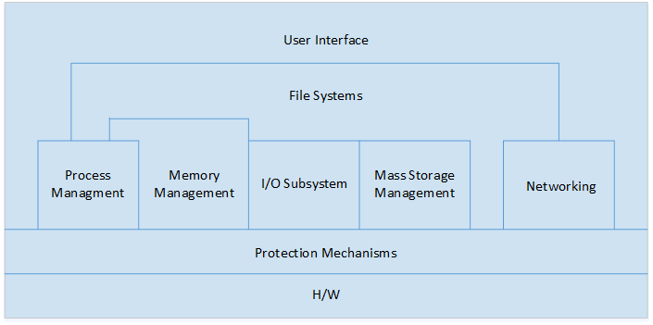
OS Components
Notes:
All components are critical to protection, security and performance of the system!

Slide 27
Operating Systems Components
Process and Threads Management
Memory Management
Storage and File System Management
Device Management
Network Management

Slide 28
Process Management
A process is a program in execution. It is a unit of work within the system. Program is a passive entity, process is an active entity. Processes can run in parallel across multiple CPU cores
Create and delete processes and threads
Schedule processes and threads on the CPUs
Suspend and resume processes
Provide mechanism for process synchronization
Provide mechanism for inter-process communication (IPC)
ITSC205 Operating Systems Internals

Slide 29
Memory Management
CPU reads instructions from main memory during the instruction-fetch cycle
Memory management activities
Keeping track of which parts of memory are currently being used and what programs are using it
Deciding which processes and data to move into and out of memory
Allocating and deallocating memory space as needed
ITSC205 Operating Systems Internals

Slide 30
File System Management
File-System management
Files usually organized into directories
Access control on most systems to determine who can access what
OS activities include:
Creating and deleting files and directories
Primitives to manipulate files and directories
Mapping files onto secondary storage
Backup files onto stable (non-volatile) storage media
ITSC205 Operating Systems Internals

Slide 31
Storage
Recall Von Neumann Architecture
One set of memory for all program and data
CPU can only load instructions from main (primary) memory
But RAM is volatile!
Secondary storage is non-volatile
SSDs, HDDs
Tertiary storage: USB drives, CDs, tapes
Usually external

Slide 32
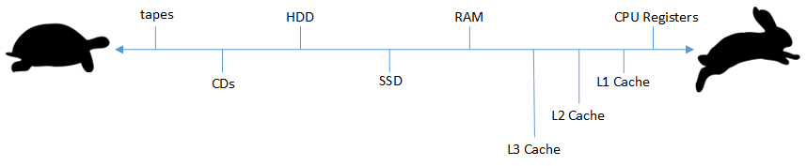
Storage Hierarchy
RAM is VERY slow compared to CPU…
Why can’t we just store everything in the registers or caches since they’re much faster?

Slide 33
Caching
Stores data locally so future requests for that data can be accessed faster
Instructions and data must be copied from disk ←→ main memory ←→ caches ←→ registers
After a value is updated in the registers, it’s different than the copy in cache, memory and disk
A big issue in multiprocessing and distributed systems – the cache coherency problem
Notes:
A cache is used for caching, but caching doesn’t always use a cache!

Slide 34
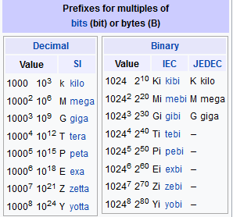
Storage Definitions and Notation Review
https://en.wikipedia.org/wiki/Byte

Slide 35
Input/Output
Compete for the system bus to access memory
Coordinated by the device controllers
OS knows how to send/receive data to each type of controller via the installed device driver
Direct Memory Access (DMA)
Reduce number of interrupts to CPU by stealing cycles
Allow device controllers to access main memory directly
Notes:
You type some characters into notepad… each character you type sends an interrupt to the CPU. CPU services the interrupt and signals to notepad that a character has been entered. Notepad receives this signal and knows it must display the character on the screen.
Notepad now sends a request to the OS for the video controller – this is a I/O command.

Slide 36
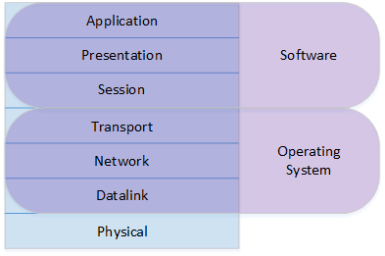
Networking
Notes:
Not covered in this course, you have many other course for this! :D

Slide 37
Computer-System Operation
I/O devices and the CPU can execute concurrently
Each device controller is in charge of a particular device type
Each device controller has a local buffer
CPU moves data from/to main memory to/from local buffers
Device controller informs CPU that it has finished its operation by causing an interrupt.
ITSC205 Operating Systems Internals

Slide 38
Common Functions of Interrupts
Interrupt transfers control to the interrupt service routine generally, through the interrupt vector, which contains the addresses of all the service routines
Interrupt architecture must save the address of the interrupted instruction
A trap or exception is a software-generated interrupt caused either by an error or a user request
An operating system is interrupt driven
ITSC205 Operating Systems Internals

Slide 39
Interrupt Service Routines (ISR)
Each interrupt must be handled differently
requires its own interrupt handler
The interrupt vector/table is an array of pointers to the ISRs
Index value correspond to the IRQ
Always in low memory and fixed location
For speed: no need to find this table first after receiving the interrupt! Just use the index and jump to that memory address

Slide 40
Handling Interrupts
What if you move the mouse and type at the same time?
Multiple interrupts can occur simultaneously
Priority of interrupt must be considered!
CPU have multiple interrupt lines
Non-maskable: Interrupt can not be ignored, used for highest priority like timers and critical H/W errors
Maskable: Interrupt can be ignored, used for everything else
Notes:
A new approach is Message Signaled-based Interrupts instead of Line-based which is more efficient. Interrupts does not have to share a IRQ and the maximum number of interrupts is not dependent on the number of physical interrupt lines to the CPU (max size = size of interrupt vector).

Slide 41
Computing environments

Slide 42
Virtualization
It is a software technology that allows operating systems to run simultaneously on the same physical machine
This software includes Emulation used when source CPU type is different from target type (i.e. PowerPC to Intel x86)
Virtualization can offer performance improvements, reduce the number of physical machines, and reduce the total cost of ownership (TCO)
Virtualization – OS natively compiled for CPU, running guest OSes also natively compiled
Virtual Machine Manager (VMM) can run natively, in which case they are also the host such as VMware ESX and Citrix XenServer

Slide 43
Virtualization

Slide 44
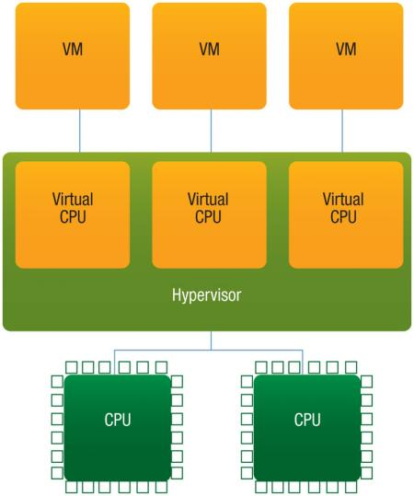
Multicore Systems and Virtualization

Slide 45
Windows Virtualization
Windows supports many virtualization features, including:
live migration. Transparently move running virtual machines either from one node of a cluster to another or from one non-clustered server to another.
dynamic virtual machine storage. Allows to add or remove virtual hard disks and physical disks while a virtual machine is running. You also can move the virtual disks of running virtual machines from one storage location to another without downtime.

Slide 46
Hyper-V architecture
Microsoft’s virtualization technology is Hyper-V. Hyper-V is a virtual machine technology that allows multiple guest operating systems to run concurrently on one computer and provide separate applications and services to client computers.
Hyper-V can be installed only on computers with 64-bit processors that implement hardware-assisted virtualization and hardware-enforced data execution protection. Specifically, you must enable virtualization support in firmware and also enable either Intel XD bit (execute disable bit) or AMD NX bit (no execute bit) as appropriate.

Slide 47
Clustered Systems
Each system with their own memory and storage, running its own OS
Connected through LANs or WANs
Performance is augmented by splitting work across the nodes
High-availability (via redundancy)
High-performance computing (via parallelization)

Slide 48
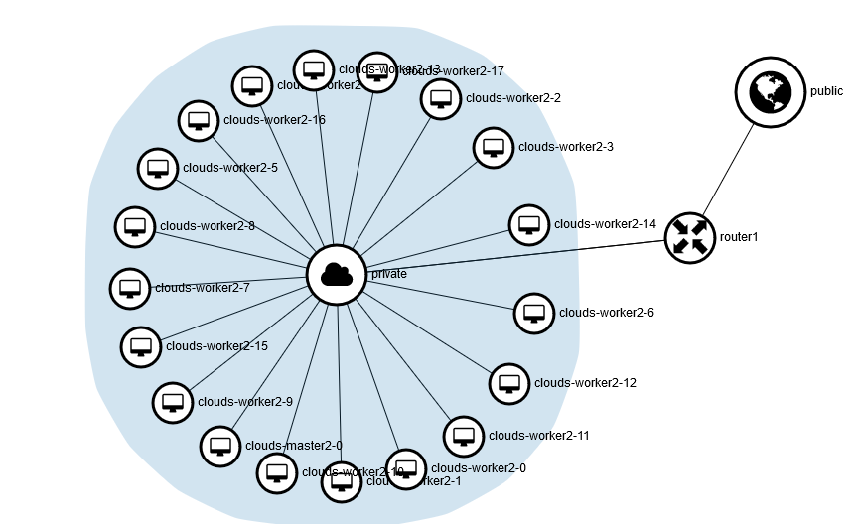
Clustered Systems

Slide 49
Cloud Computing
Extending on virtualization to send processing power, data and applications to users
‘X’aaS (IaaS, PaaS, SaaS etc.)
Can be deployed as Public, Private or Hybrid
Major security and privacy concerns!
Why?

Slide 50
Cloud Computing

Slide 51
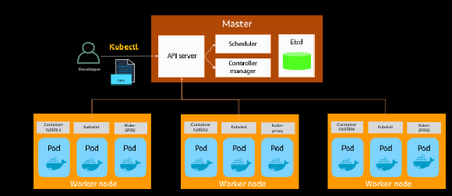
Kubernetes
From AWS innovate – amazon.com
https://onlinexperiences.com/scripts/Server.nxp

Slide 52
Cloud Computing
What is Cloud Computing
https://aws.amazon.com/what-is-cloud-computing/?nc1=f_cc
Cloud Computing-Open Stack
https://www.youtube.com/watch?v=Qz5gyDenqTI
Amazon EC2
http://www.youtube.com/watch?v=OLfmqcYnhUM
http://aws.amazon.com/ec2/
Google data center
http://www.youtube.com/watch?v=PBx7rgqeGG8
Windows Azure
http://channel9.msdn.com/Blogs/dunnry/What-is-Windows-Azure

Slide 53
Mobile Operating Systems
Handheld smartphones, tablets, etc
What is the functional difference between them and a “traditional” laptop?
Extra feature – more OS features (GPS, gyroscope)
Allows new types of apps like augmented reality
Use IEEE 802.11 wireless, or cellular data networks for connectivity
Leaders are Apple iOS and Google Android

Slide 54
Real-Time Embedded Systems
The most common type of “computer”!
Inside everything we use – cars, microwaves, coffee makers…
“embedded” inside another H/W or mechanical device (all IoT)
Smaller, cheaper, uses less power
At the expense of very limited/dedicated functionality
Mostly customized for their purpose
Premade: Raspberry Pi, Arduino
Real-time constraints!
Hard vs. soft

Slide 55
Open-Source Operating Systems
A powerful force in the development of OSes is open-source computing: those systems where the source code is available to users who wish to modify and extend the code
This movement is not new!
Best known open-source OSes are Linux and BSD
Based on the Unix OS (commonly known as “Unix-variant”)

Slide 56
Linux
Created by Linus Torvalds originally for the Intel 80386 processor
A group of developers adopted Linux as the basis for the development of a freely available system and it grew from there to now ~12,000 contributors!
Various distributions of Linux package the system for private and commercial use

Slide 57
Windows
Not open-source…
Dominated the PC era
A “family” of OSes for different type of systems
Windows NT: PCs and servers (Windows 10, Windows Server 2016)
Windows Embedded: being rebranded as Windows IoT
Windows Phone: being phased out to Windows 10 Mobile
Specialized version on Xbox One

Slide 58
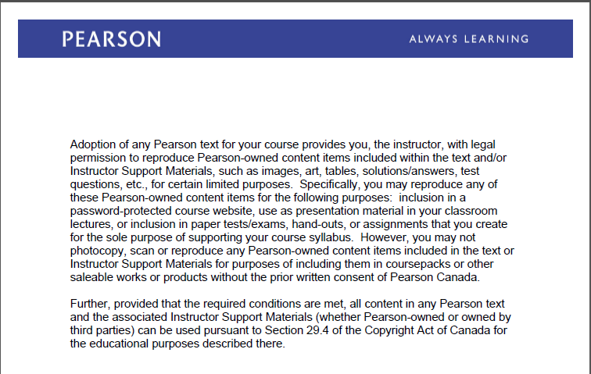
Text Book Slides -Copy Right

